Slide 1
Chapter 2
Neuroscience and Behavior

Slide 2
I. Neural Communication
Neurons – Nerve cells; Basic building block of the nervous system.
Dendrite – Bushy, branching extension that receives messages and conducts impulses toward the cell body.
Axon – Extension of a neuron, ending in branching terminal fibers, through which messages are sent to other neurons, muscles or glands.
Myelin Sheath – Layer of fatty tissues encasing the fibers of many neurons. It enables faster transmission speeds for the neural impulse.
Action Potential – Neural impulse; Brief electrical charge that travels down an axon.
Threshold – Level of stimulation required to trigger a neural impulse.

Slide 3
I. Neural communication

Slide 4
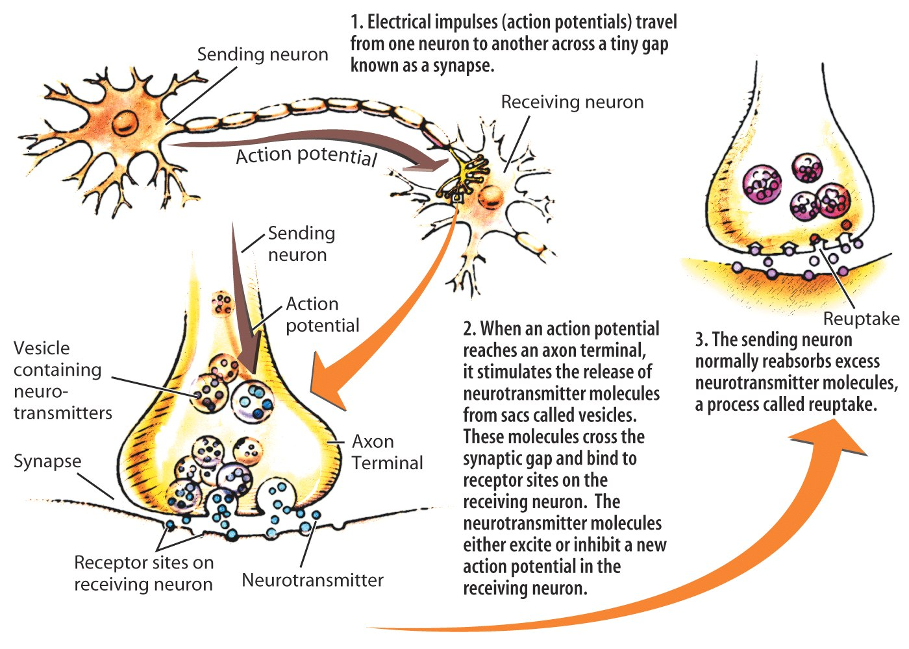
I. Neural Communication
Synapse – Junction between the axon of the sending neuron and the dendrite of the receiving neuron.
Neurotransmitters – Chemical messengers that traverse the synaptic gap between neurons.
Neuron Video

Slide 5
I. Neural communication
Neurotransmitter’s influence
Examples of neurotransmitters
Dopamine – influences movement, learning, attention and emotion
Serotonin – Affects mood, hunger, sleep and arousal
Norepinephrine – Control alertness and arousal
Acetylcholine (ACh) – Triggers muscle contraction and, if blocked, muscles cannot contract
Endorphines – Natural opiate like neurotransmitter linked to pain control
How drugs alter neurotransmission
Agonist – Drug that excites by mimicking a neurotransmitter
Antagonist – Drug that inhibits by blocking neurotransmitters or diminishing their release
Drug and neurotransmission video

Slide 6
II. The Nervous System

Slide 7
II. The Nervous System
Nervous System – Body’s speedy electrochemical communication system, consisting of the central nervous system and the peripheral nervous system. (video)
Types of Neurons
Sensory Neurons – Carry incoming information from the sense receptors to the central nervous system.
Interneurons – Central nervous system neurons; Internally communicate and intervene between sensory inputs and motor outputs.
Motor Neurons – Carry outgoing information from the central nervous system to the muscles and glands. (video)

Slide 8
II. The Nervous System

Slide 9
II. The Nervous System
Peripheral Nervous System – The sensory and motor neurons that connect the central nervous system to the rest of the body.
Somatic nervous system – Controls the body’s skeletal muscles.
Autonomic nervous system – Controls the glands and muscles of the internal organs.
Sympathetic nervous systm – Arouses the body, mobilizing its energy in stressful situations (fight or flight)
Parasympathetic nervous system – Calms the body, conserving its energy

Slide 10
II. The Nervous System

Slide 11
II. The Nervous System
Central Nervous System – The brain and spinal cord.
Reflexes – A simple automatic response to a sensory stimulus, such as the knee-jerk response.
Paralysis – Brain does not receive neural messages from neurons below the point of the severed spinal cord, resulting in loss of sensation.
Neural Networks – Interconnected neural cells.

Slide 12
III. The Brain
Tools of Discovery
Lesion – Naturally or experimentally caused destruction of brain tissue.
Clinical observation
Manipulating the brain (ex. Magnetically stimulating the brain.)
Recording the brain’s electrical activity (ex. EEG)
Neuroimaging techniques
CT Scan (Computed Tomography
PET Scan (Positron Emission Tomography)
MRI (Magnetic Resonance Imaging)

Slide 13
III. The Brain (video)
Brain Structures
Brainstem – Central core of the brain, beginning where the spinal cord swells as it enters the skull. Responsible for automatic survival functions. (Medulla and Reticular Formation)
Thalamus – Brain’s sensory switchboard that directs messages to the sensory receiving areas of the cortex and transmits replies to the cerebellum and medulla.
Cerebellum – Helps coordinate voluntary movement and balance.
Limbic System
Amygdala – Almond shaped neural clusters linked to emotion.
Hypothalamus – Directs maintenance activities (eating, drinking, body temperature), governs the endocrine system and is linked to emotion.

Slide 14
III. The Brain
Brain Structures
Cerebral Cortex – Ultimate control and information processing center (like bark on a tree).
Glial cells – Cells in the nervous system that nourish and protect neurons.
Frontal lobes – Involved in speaking and movement and making plans and judgment.
Parietal lobes – Includes the sensory cortex.
Occipital lobes – Includes visual areas which receive information from the opposite visual field.
Temporal lobes – Includes auditory areas, receive information from the opposite ear.

Slide 15
III. The Brain
Brain Structures
Functions of the cortex
Motor cortex – An area at the rear of the front lobes that controls voluntary movements.
Sensory cortex – An area at the front of the parietal lobes that registers and processes body sensations.
Association areas – Higher mental functions such as learning, remembering, thinking and language.
Aphasia – Impairment of language caused by damage to Broca’s Area or Wernicke’s Area
Broca’s area – Area that directs the muscle movements involved in speech. (video)
Wernicke’s area – Involved in language comprehension and expression located in the temporal lobe. (video)
Plasticity – Brain’s capacity for modification.

Slide 16
III. The Brain
Our Divided Brain
Splitting the brain
Corpus callosum – Large band of neural fibers connecting the two brain hemispheres and carrying messages between them.
Split brains – Condition in which the corpus callosum is severed, leaving the two hemispheres isolated. (video)
Hemispheric differences
Left – quick, literal interpretation of language
Right – excels in making subtle inferences

Slide 17
IV. Endocrine System
Endocrine system – A set of glands that secrete hormones into the bloodstream.
Hormones – Chemical messengers, mostly those manufactured by the endocrine glands, that are produced in one tissue and affect another.
Adrenal glands – Pair of glands that secrete the hormones epinephrine (adrenaline) and nor-epinephrine, which help to arouse the body in times of stress.
Pituitary gland – Most influential gland, under the influence of the hypothalamus, that regulates growth and controls the other glands.
Neurotransmitters are released by neurons and hormones are released by glands.

Slide 18
IV. The Endocrine System

