Slide 1
The Developing person
Chapter 4

Slide 2
I. Prenatal Development and the Newborn
Prenatal Development (slideshow)
Zygote – The fertilized egg from conception to 2 weeks.
Embryo – The developing human organism from about 2 weeks after fertilization through the second month.
Fetus – Developing human organism from 9 weeks after conception to birth.
Teratogens – Agents that can breach the embryo or fetus during the prenatal development and cause harm (ex: Drugs, alcohol, nicotine)
Fetal Alcohol Syndrome – Physical and cognitive abnormalities in children caused by heavy drinking during pregnancy. (leading cause of mental retardation)

Slide 3
I. Prenatal Development and the Newborn
The Competent Newborn
Rooting Reflex – A baby’s tendency, when touched on the cheek, to open the mouth and search for the nipple.
What can babies sense?
Born preferring faces
Turn toward human voices
Prefer to look at things 8-12” away
Within the first week, can detect their mother’s smell from others

Slide 4
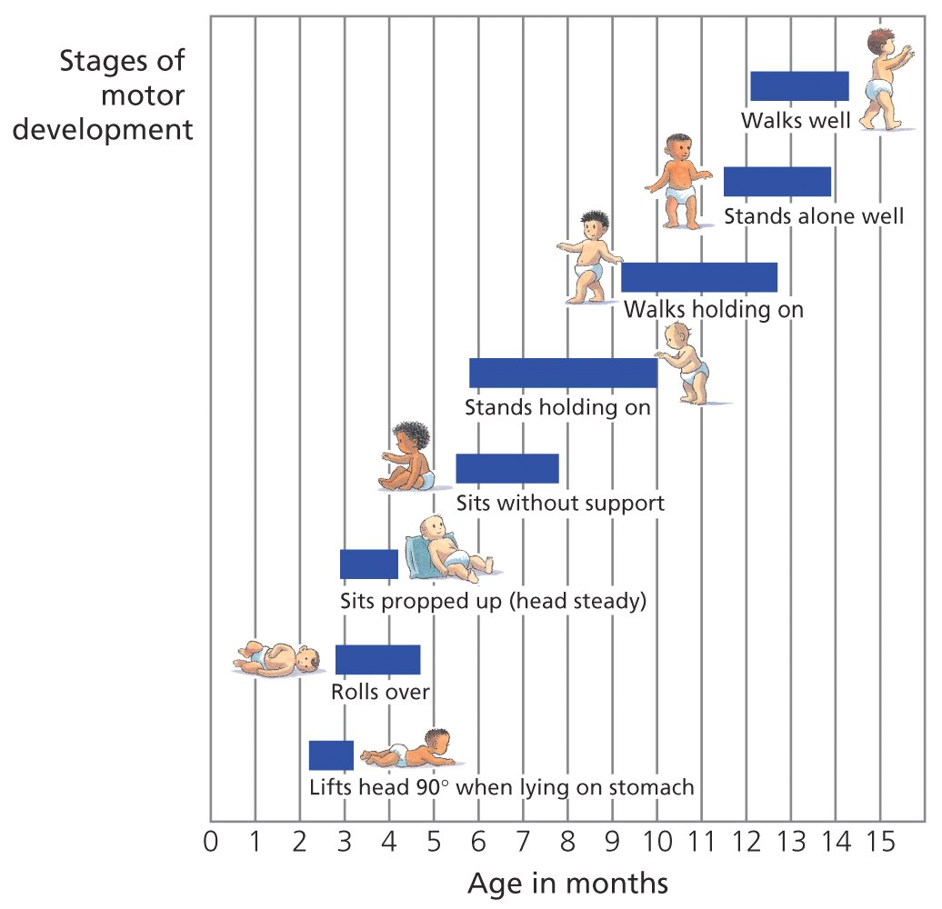
II. Infancy and Childhood
Physical Development
Maturation – Biological growth processes that enable orderly changes in behavior, relatively uninfluenced by experience.
Maturation sets the course of development, experience adjusts it.

Slide 5
II. Infancy and Childhood
Cognitive Development
Piaget said the child’s mind is not a miniature model of an adult’s mind and it develops through stages.
Schemas – A concept or framework that organizes and interprets information.
Assimilation – Interpreting one’s new experience in terms of an existing schema.
Accommodation – Adapting one’s current schema to incorporate new information.
Video example

Slide 6
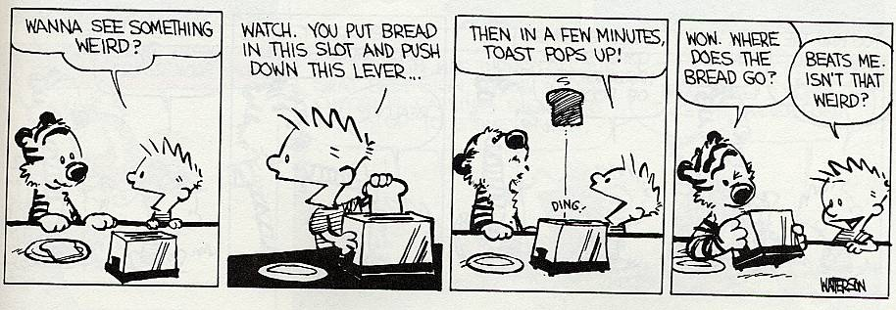
II. Infancy and Childhood
Piaget’s Theory
Sensorimotor (birth – 2 years)- Infants know the world mostly in terms of their sensory impressions and motor activities.
Object Permanence – Awareness that things continue to exist even when not perceived. Watch an example.

Slide 7
II. Infancy and Childhood
Piaget’s Theory
Preoperational (2-6/7 years) – Child learns to use language but does not comprehend mental operations of concrete logic.
Conservation – Principle that properties such as mass, volume and number remain the same despite changes in the forms of objects. Example
Egocentrism – Inability of the child to take another’s point of view. Example
Theory of mind – Ideas about own and others mental states (Growing ability to tease, empathize and persuade.)

Slide 8
II. Infancy and Childhood
Piaget’s Theory
Concrete Operational Stage (6/7-12 years) – Children gain the mental operations that enable them to think logically about concrete events.
Formal Operational Stage (12+ years) – People begin to think logically about abstract concepts. Example
Reflections on Piaget
Stage theory is controversial – today development is seen as continuous.
Must focus on the sequence, not the ages.

Slide 9
II. Infancy and Childhood
Social Development
Stranger anxiety – Fear of strangers that infants commonly display, beginning about 8 months of age.
Attachment – emotional tie with another person; children seek closeness to a caregiver and show distress on separation.

Slide 10
II. Infancy and Childhood
Social Development
Origins of attachment
Body Contact – Harry Harlow found monkeys preferred the soft comforting “mother” over the “mother” with the bottle. Example
Familiarity – Konrad Lorenz imprinted ducklings on himself but found it hard to reverse. Example
Critical Period – Optimal period shortly after birth when an animal’s exposure to certain stimuli produce development.
Imprinting – Process where certain animals form attachments during a critical period early in life.

Slide 11
II. Infancy and Childhood
Social Development
Effects of attachment
Secure attachment predicts social competence
Deprivation of attachment often leads to the unloved becoming the unloving
Anything that prevents attachment is disruptive
Good daycare does not effect attachment and has proven to be beneficial for children 2 and over (unresolved for infants)

Slide 12
II. Infancy and Childhood
Social Development
Self Concept – A sense of one’s identity and personal worth (stable by 8-10 years old)
Parenting Styles
Authoritarian – Parents impose rules and expect obedience.
Permissive – Parents submit to child’s desires, make few demands and use little punishment.
Authoritative – Demanding and responsive. Parents set and enforce rules but also explain reasons and encourage discussion.

Slide 13
III. Adolescence
Adolescence – Transition from childhood to adulthood, extending from puberty to independence.
Physical Development
Puberty – Period of sexual maturation, during which a person becomes capable of reproducing (girls: around 11, boys: around 13)
Primary sex characteristics – The body structures that make sexual reproduction possible.
Secondary sex characteristics – Non-reproductive sex characteristics such as female breasts and hips and male voice change and hair.
Menarche – first menstrual period.
Early maturation
Boys: positive (More popular, self assured and independent)
Girls: stressful (Associating with older teens and suffer teasing)

Slide 14
A woman was near death from a special kind of cancer. There was one drug that the doctors thought might save her. It was a form of radium that a druggist in the same town had recently discovered. The drug was expensive to make, but the druggist was charging ten times what the drug cost him to produce. He paid $200 for the radium and charged $2,000 for a small dose of the drug. The sick woman's husband, Heinz, went to everyone he knew to borrow the money, but he could only get together about $1,000 which is half of what it cost. He told the druggist that his wife was dying and asked him to sell it cheaper or let him pay later. But the druggist said: "No, I discovered the drug and I'm going to make money from it." So Heinz got desperate and broke into the man's store to steal the drug for his wife.
Should Heinz have broken into the store to steal the drug for his wife? Why or why not?

Slide 15
III. Adolescence
Cognitive Development
Develop reasoning power (formal operational stage – capable of abstract logical thought)
Developing morality
Kohlberg’s levels of moral reasoning
Pre-conventional morality (<9yrs) – Obey either to avoid punishment or gain concrete rewards.
Conventional morality (early adolescence) – Gain social approval or help maintain the social order.
Post-conventional morality (controversial) – Affirms people’s agreed upon rights or perception of basic ethical principles.
There is a slack between moral reasoning and moral actions. (People may do things that they don’t believe are moral)
Kohlberg Video

Slide 16
III. Adolescence
Social Development
Erik Erickson – Psychologist who believed that each stage of life has its own psychological task, a crisis that needs resolution.
Erickson’s stages of Psychosocial Development:
Trust vs. mistrust (0-1)
Autonomy vs. shame/doubt (1-2)
Initiative vs. guilt (3-5)
Competence vs. inferiority (6-12)
Identity vs. role confusion (13-20)
Intimacy vs. isolation (20-40)
Generativity vs. stagnation (40-60)
Integrity vs. despair (60+)

Slide 17
IV. Adulthood
Physical changes
Menopause – Natural cessation of the menstrual cycle
No equivalent stage in men but they do experience gradual declines in hormones
Our culture tries to mask aging (video)
Late adulthood
Life expectancy (interesting….)
Sensory abilities decrease with age
Immune system weakens but a high accumulation of antibodies results in less colds and flus
Reaction time slows
Brain regions important to memory shrink
More active younger = more vigor older
Dementia – Mental erosion
Alzheimer’s Disease – A progressive and irreversible brain disorder characterized by gradual deterioration of memory, reasoning, language and physical functioning. (video)

Slide 18
IV. Adulthood
Cognitive Changes
Older people have a hard time with recall but recognition stays constant.
There is less decline if information is meaningful.
Crystallized intelligence – One’s accumulated knowledge and verbal skills; Tends to increase with age.
Fluid intelligence – One’s ability to reason speedily and abstractly; Tends to decrease during late adulthood.

Slide 19
IV. Adulthood
Social Changes
Evidence of a mid-life crisis is not supported
Social clock – The culturally preferred timing of social events such as marriage, parenthood, and retirement.
Life events – Marriage, parenthood, vocational changes, divorce, empty nest, relocation, retirement.
Emotional comparison (teenagers – emotional roller coaster, old age- paddling a canoe)
Range of reactions to death and dying is wide – some grieve hard and for a long time while others grieve lightly and briefly.

Slide 20
IV. Adulthood
Adulthood commitments:
Love
More satisfying when marked by similar interests
More likely to last when marriage after age 20 and both are well educated
Married couples report being happier than singles
“Empty Nest” is usually a happy place
Work
For many, who you are = what you do
Happiness = finding work that fits your interests

