Slide 1
Chapter 5
Sensation

Slide 2
I. Sensing the World – Basic Principles
Sensation – The process by which you detect physical energy from your environment and encode it as a neural signal.
Thresholds
Psychophysics – Study the relationship between physical energy and psychological experiences.
Absolute thresholds – Weakest level of a stimulus that can be detected half of the time.

Slide 3
I. Sensing the World – Basic Principles
Thresholds
Difference Thresholds – Minimum difference between any two stimuli that can be detected half of the time.
Just Noticeable Difference
Weber’s Law – The stronger the stimulus, the more change necessary to notice a difference.
Signal Detection Theory – Assumes no actual threshold but that threshold changes with a variety of factors (ex: fatigue, attention, expectations, motivation and emotional stress)

Slide 4
I. Sensing the World – Basic Principles
Thresholds
Subliminal stimulation – Receipt of messages that are below ones absolute threshold for conscious awareness.
We can process information without being aware of it.
Subliminal sensation is not the same as subliminal persuasion.
Sensory adaptation – When stimulation is unchanging, you become less sensitive to it. (Can you think of an example of this?)

Slide 5
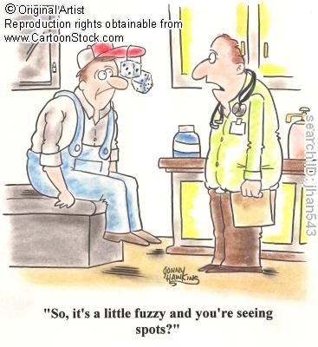

Slide 6
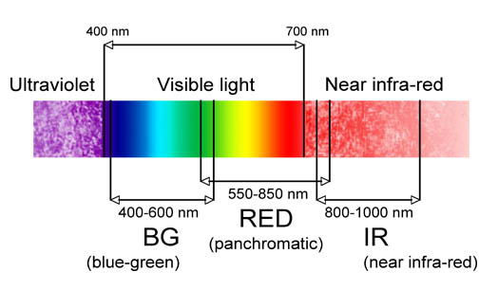
II. Vision
Stimulus input: Light Energy
Wavelength – Distance from the peak of one light or sound wave to the peak of the next.
Hue – Dimension of color determined by wavelength.
Intensity – Our perception of brightness or loudness, determined by a wave’s altitude (height)

Slide 7
II. Vision
The eye
Pupil – Where light enters the eye.
Iris – Ring of muscle that controls the size of the pupil opening.
Lens – Structure behind the pupil that changes shape to focus images on the retina.
Retina – Light sensitive surface in the back of the eye containing rods and cones that transduces light energy.
Rods – Detect black, white, gray and movement; Necessary for peripheral and twilight vision.
Cones – Detect color and fine detail in daylight or bright light conditions.

Slide 8
II. Vision
The eye
Optic nerve – Carries neural impulses from the eye to the thalamus of the brain.
Fovea – Central focal point in the retina around which the eye’s cones cluster.
Blind spot – Region of the retina where the optic nerve leaves the eye.
Acuity – Ability to detect detail, sharpness of vision.
Nearsighted – Too much curvature of the cornea and/or lens focuses images in front of the retina so nearby objects are seen more clearly.
Farsighted – Too little curvature of the cornea and/or lens focuses images behind the retina so distant objects are seen more clearly.

Slide 9
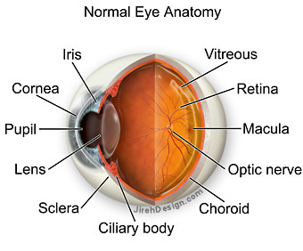

Slide 10
II. Vision
Visual information processing
Feature detection – Nerve cells in the brain that respond to specific features of the stimulus such as shape, angle or movement.
Parallel processing – Simultaneously analyzing different elements of sensory information (ex: color, brightness, shape)

Slide 11
II. Vision
Color vision
Color is our mental construction
Tri-chromatic theory – Theory that retina contains 3 different color receptors (red, green, blue) which, when stimulated in combination, produce the perception of color.
Opponent process theory – Theory that opposing retinal processes (red-green, blue-yellow, black, white) enable color vision. (What does that look like?)
Color constancy – Knowing the color of an object doesn’t change even if it seems to.

Slide 12
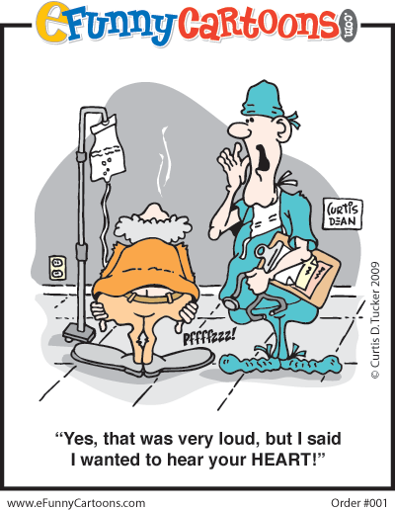

Slide 13
III. Hearing
Audition – The sense of hearing.
Stimulus Input: Sound Waves
Frequency – Number of complete wavelengths that pass a point in a given time.
Pitch – A tone’s highness or lowness that depends on frequency.
What is the difference between noise and music?

Slide 14
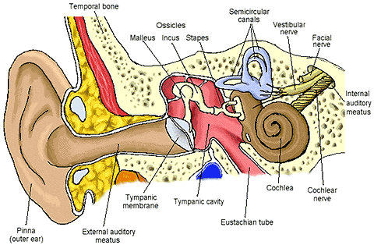
III. Hearing
The Ear
Sequence: Auditory canal, eardrum, middle ear, inner ear (cochlea), basilar membrane, nerve fibers, auditory nerve, temporal lobe’s auditory cortex

Slide 15
III. Hearing
The Ear
Cochlea – A snail shaped fluid filled tube in the inner ear, with hair cells on the basilar membrane that trigger nerve impulses.
Auditory nerve – Transmits sound messages to the temporal lobe.

Slide 16
III. Hearing
The Ear
How do we perceive pitch?
Place Theory – The position on the basilar membrane at which waves reach their peak; accounts well for high pitched sounds.
Frequency Theory – The rate of the neural impulses traveling up the auditory nerve matches the frequency of the tone, enabling you to sense pitch; explains low pitch.
How do we locate sound?
Stereophonic hearing (3D)
Differences in intensity between left and right ear

Slide 17
III. Hearing
Hearing Loss
Conduction deafness – Hearing loss caused by damage to the mechanical system that conducts sound waves to the cochlea. (A hearing aid may restore hearing.)
Nerve (sensorineural) deafness – Hearing loss caused by damage to the cochlea’s receptor cells or to the auditory nerve. (Only way to restore hearing is a cochlear implant.)
How a cochlear implant works
Cochlear implant activation

Slide 18
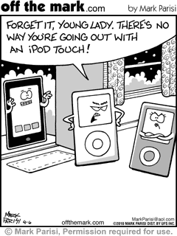

Slide 19
IV. The Other Senses
Touch – This is actually a mix of four distinct skin senses (Pressure, warmth, cold and pain)
Most sensitive to unexpected stimulation
Pain
Body’s way of telling you something has gone wrong
What if you couldn’t feel pain?
Gate-control theory – Idea that the spinal cord contains a neurological “gate” that blocks pain signals or allows them to pass to the brain.
Pain control therapies: Drugs, surgery, acupuncture, massage, exercise, hypnosis, relaxation training

Slide 20
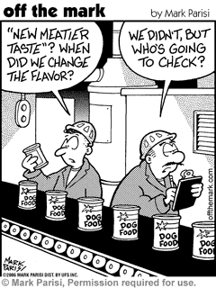

Slide 21
IV. The Other Senses
Taste – Involves four basic elements (sweet, sour, bitter and salty)
Chemical sense
Taste buds reproduce themselves every week or two and decrease with age.
Sensory interaction – Principle that one sense may influence another (smell and taste)
Are you a supertaster?

Slide 22
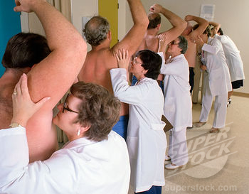
When you are having a bad day, just remember that it could always be worse. You could have this job….

Slide 23
IV. The Other Senses
Smell
Chemical sense
Olfactory nerve – Transmits the scent message to the brain (bypasses the thalamus).
Body position and movement
Kinesthesis – System for sensing the position and movement of individual body parts.
Vestibular sense – Body sense of equilibrium located in the semi-circular canals of the inner ear.

