Slide 1
Perception
Chapter 6
Street Art and Optical Illusions

Slide 2
I. Selective attention
Selective attention – The focusing of conscious awareness on a particular stimulus.
Count the passes video
Cocktail party effect – Ability to attend selectively to only one voice among many.
We can attend to stimuli we don’t notice.
Who Cheated video

Slide 3
II. Perceptual illusions
Visual capture – Vision usually dominates when there is a conflict among senses.
Franz Muller-Lyer Illusions
Ames Room Illusion
Gateway Arch in St. Louis
Ex: Bracing ourselves when watching a roller coaster movie

Slide 4
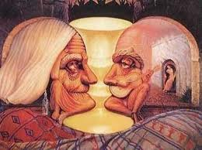
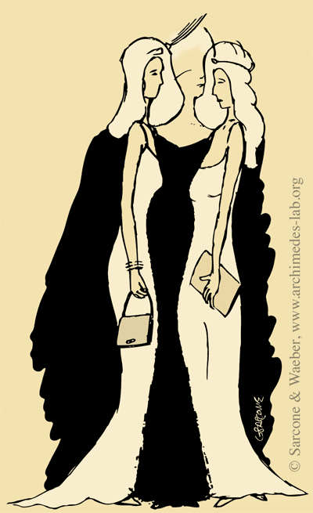
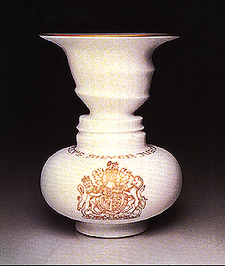
III. Perceptual organization
Gestalt – Our tendency to integrate pieces of information into meaningful wholes.
“The whole is greater than the sum of its parts.”
Form Perception
Figure-Ground – Organization of the visual field into objects (figures) that stand out from their surroundings (ground)

Slide 5
iii. Perceptual organization
Form Perception
Grouping – Tendency to organize things into coherent groups
Proximity – Group close objects together
Similarity – Group similar objects
Continuity – Perceive smooth continuous patterns
Connectedness – When uniform and linked we perceive dots, lines or area as a single unit
Closure – Fill in gaps to create a whole object

Slide 6
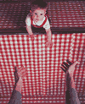
III. Perceptual organization
Depth perception – Ability to judge the distance of objects.
Visual cliff – Lab device for testing depth perception in infants and young animals.
Visual cliff experiment
Binocular cues – Clues about distance requiring two eyes.
Retinal disparity – The slightly different view the two eyes have of the same object.
Convergence – Extent to which the eyes turn inward when looking at an object.

Slide 7
iii. Perceptual organization
Monocular Cues – Clues about distance based on the image of one eye.
Interposition
Relative size
Relative clarity
Texture gradient
Relative height
Motion parallax
Linear perspective
Light and shadow

Slide 8
iii. Perceptual organization
Motion perception
Stroboscopic movement – Brain interprets a rapid series of slightly varying images as movement. (Think flip books…) Intermission
Phi phenomenon – Illusion of movement created when two or more adjacent lights blink off and on in succession. (Think chasing lights…) Sandstorm

Slide 9
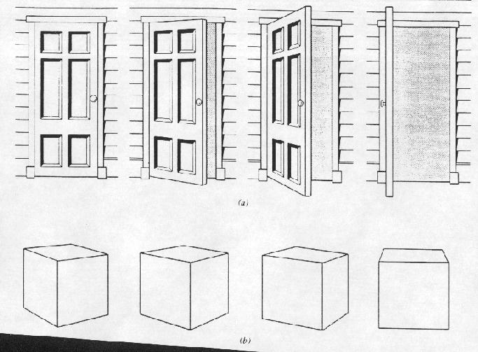
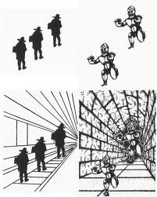
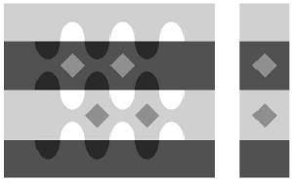
iii. Perceptual organization
Perceptual Constancy – Perceiving an object as unchanging even when the immediate sensation of the object changes.
Shape constancy
Size constancy
Lightness Constancy

Slide 10
IV. Perceptual interpretation
Perceptual adaptation – In vision, the ability to adjust to an artificially displaced or even inverted visual field. Experiment
Perceptual set – A mental predisposition to perceive one thing and not another.
Give it a try…
What we see is effected by our experiences, assumptions and expectations.

Slide 11
V. Extrasensory perception
ESP – Controversial claim that perception can occur apart from sensory input.
Parapsychology – Study of paranormal events that investigates claims of ESP.
Varieties of ESP
Telepathy – Mind to mind communication
Clairvoyance – Perceiving remote events
Precognition – Perceiving future events
Psycho kinesis – Mind over matter
ESP has never been experimentally proven (ESP and probability)

