Slide 1
Chapter 8
Learning – Relatively permanent change in behavior as a result of experience.

Slide 2
I. Classical Conditioning
Classical Conditioning – Subject learns to give a response it already knows to a new stimulus.
Pavlov’s Experiments
Unconditioned Stimulus (UCS) – Automatically or reflexively brings about a response (Ex: Meat)
Unconditioned Response (UCR) – Unlearned, naturally occurring response to the UCS (Ex: Salivation)
Conditioned Stimulus (CS) – A previously neutral stimulus that, after pairing with the UCS, elicits the conditioned response (Ex: Bell)
Conditioned Response (CR) – The learned response to a previously neutral stimulus (Ex: Salivation)

Slide 3
I. Classical Conditioning
Pavlov demonstrated the procedures of classical conditioning by using meat to train a dog to salivate to the sound of a tuning fork. Video

Slide 4
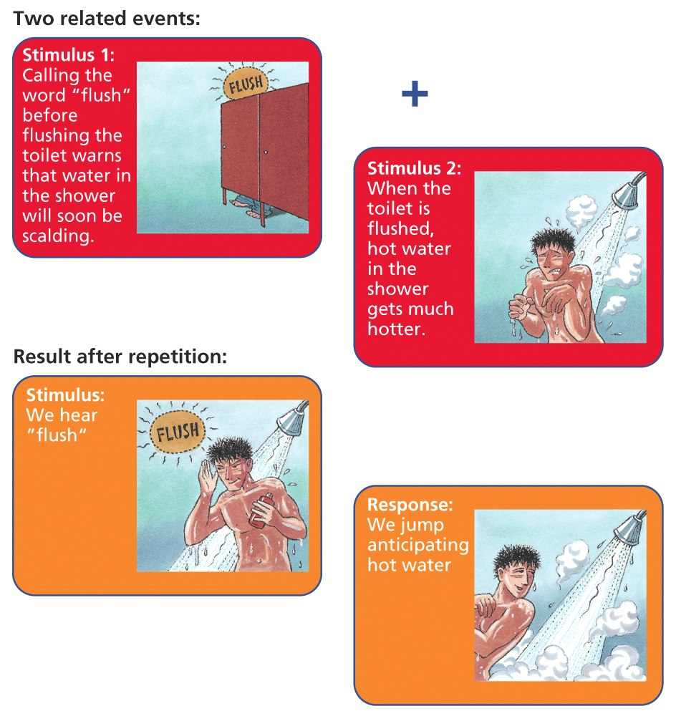
I. Classical Conditioning
Classical conditioning led a group of dorm-mates to respond to the word Flush! the same way they responded to painfully hot water.

Slide 5
I. Classical Conditioning
Extinction – Weakening of the conditioned association.
Spontaneous Recovery – After extinction, and without training, the previous CS suddenly elicits the CR again temporarily.
Generalization – Stimuli similar to the CS also elicits the CR without training.
Discrimination – Ability to tell the difference between stimuli so that only the CS elicits the CR.
Understandable Example: Taste Aversion! (Most have experienced this as some point in their lives…)

Slide 6
I. Classical Conditioning
Kim was very nervous about her upcoming chemistry exam. She had studied very hard. On the day of the big exam, she happened to get a stomach flu and subsequently did not do well on her test. Now when she even begins studying for any exam, she feels sick to her stomach. Identify the elements of classical conditioning.
Unconditioned Stimulus (UCS) –
Unconditioned Response (UCR) –
Conditioned Stimulus (CS) –
Conditioned Response (CR) –
Stomach Flu
Sick to stomach
Studying for an exam
Sick to stomach

Slide 7
I. Classical Conditioning
At the beginning of the school year, a relatively quiet new beeping fire alarm was installed. When it went off one day for a fire drill in September, the students didn’t respond to this new sound. Teachers had to usher them out the door. However, in October the new beeping alarm went off as the halls filled with smoke. Frightened students hurried out of the school to safety. In November, the beeping alarm went off again, and the students again hurried out fearfully. However, this time it was only a fire drill, so there was no fire. Then for 10 days straight in December, the alarm malfunctioned and went off daily. Now no one paid any attention to it again. After Christmas break, the alarm was repaired and went off as scheduled for a drill in January. Several students jumped anxiously, remembering the October fire. Identify the following elements of classical conditioning.

Slide 8
I. Classical Conditioning
Unconditioned Stimulus (UCS)
Unconditioned Response (UCR)
Conditioned Stimulus (CS)
Conditioned Response (CR)
Extinction
Spontaneous Recovery
Fire/Smoke
Running/Scared
Fire alarm
Running/Scared
No response to malfunction in December
Response to the alarm in January

Slide 9
I. Classical Conditioning
Pavlov’s Legacy
Classical Conditioning is one way that virtually all organisms learn to adapt to their environment.
Pavlov showed how a process (such as learning) can be studied objectively.
John Watson and Little Albert – A small child was conditioned to fear a white rat.

Slide 10
II. Operant Conditioning
Would you like a chocolate?
Operant Conditioning – Type of learning in which behavior is strengthened if followed by a reinforcer and diminished if followed by a punishment.
Skinners experiments
Law of Effect – Behavior followed by favorable outcomes are more likely to be repeated and those followed by unfavorable outcomes, less likely.
Shaping – Procedure in which reinforcers guide behavior toward a closer and closer approximation of a desired goal. (ex: animal training)
Skinner Box

Slide 11
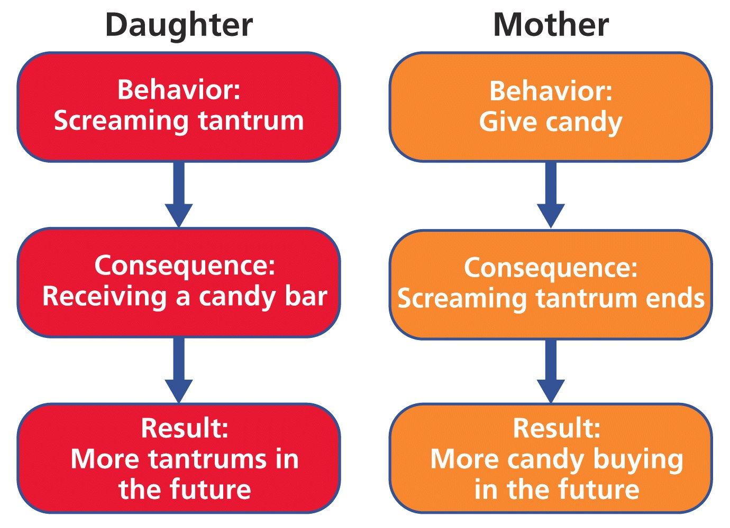
II. Operant Conditioning

Slide 12
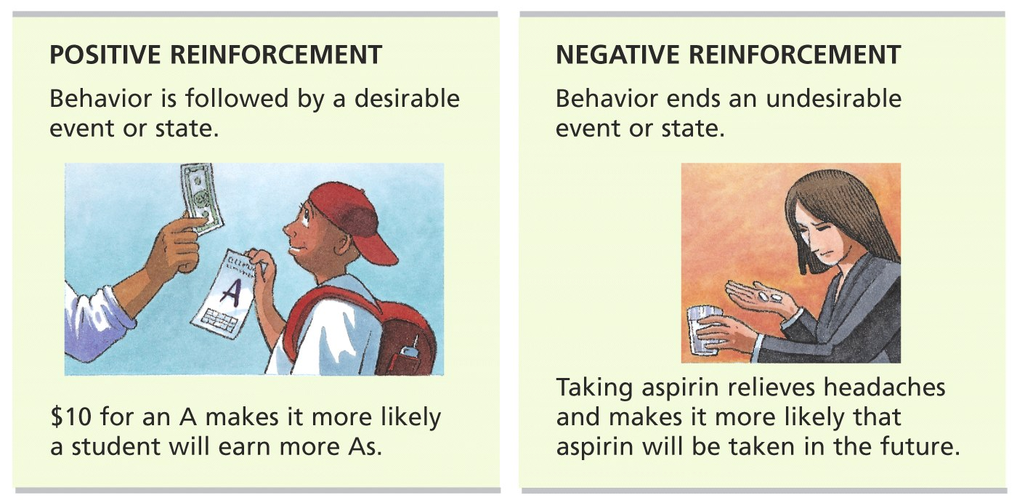
II. Operant Conditioning
Principles of Reinforcement
Reinforcement – Any event that strengthens the behavior that it follows.
Positive reinforcement – Strengthens by presenting (adding) a favorable consequence.
Negative reinforcement – Strengthens by removing (subtracting) an unfavorable consequence.

Slide 13
II. Operant Conditioning
Principles of Reinforcement
Primary reinforcer – Something that is biologically important, therefore rewarding.
Secondary reinforcer – Something rewarding because it is associated with a primary reinforcer.
Immediate reinforcement is best.
A sign of maturity is the ability to delay gratification.

Slide 14
II. Operant Conditioning
Extra Help
Positive means something is given or added
Negative means something is removed or subtracted
Negative Reinforcement ≠ Punishment (Remember: Reinforcement increases behavior and punishment decreases behavior!)
Examples of Negative Reinforcement:
Taking Tylenol to reduce a headache
Fanning yourself to escape the heat
Leaving a movie if it is bad
Following prison rules to be released early
Putting on a seatbelt to stop an irritating buzz
Putting up an umbrella to escape the rain

Slide 15
II. Operant Conditioning
Continuous reinforcement – A reward follows every correct response, which is useful for establishing new behaviors but very easy to extinguish.
Partial Reinforcement
Fixed Interval Schedule – Reinforce the first correct response after some pre-set time.
Studying for weekly quizzes/tests
Variable Interval Schedule – Rewards the first correct response after an unpredictable amount of time.
Pop quiz schedule
Fixed Ratio Schedule – Rewards a response only after a defined number of correct responses.
Rent ten videos get one free
Variable Ratio Schedule – Rewards an unpredictable number of correct responses.
Gambling – slot machines/lotto tickets

Slide 16
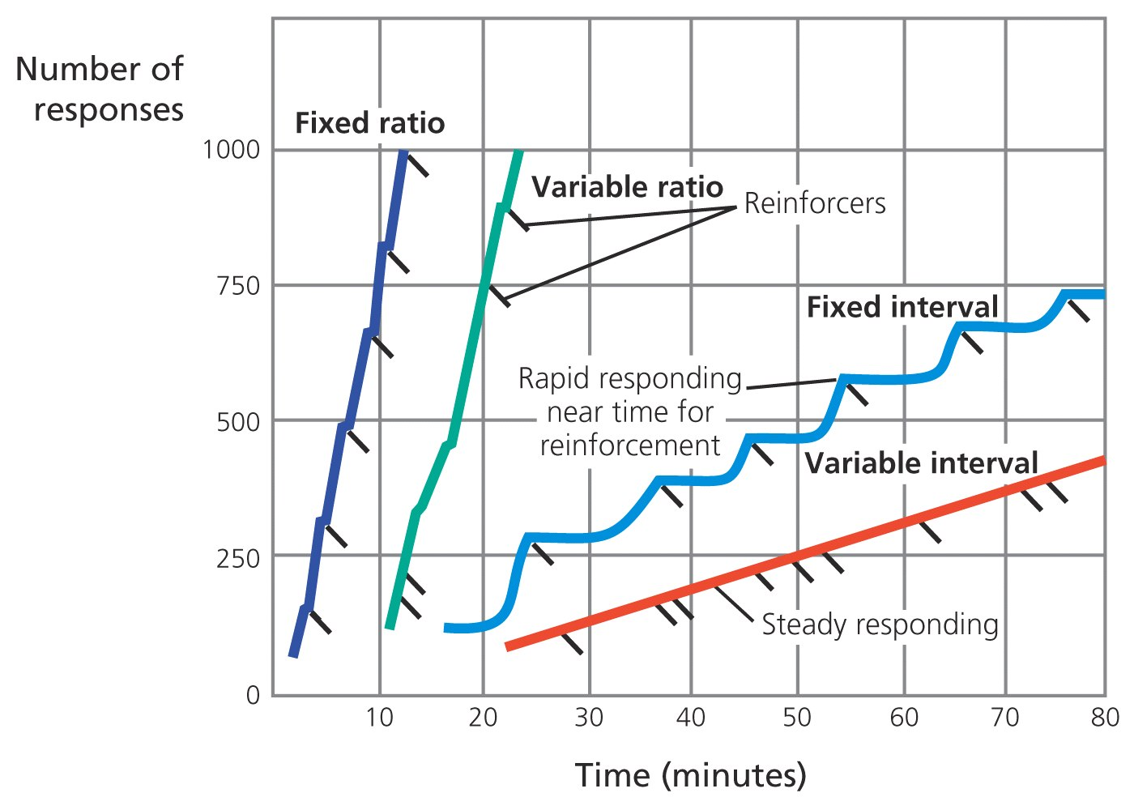
II. Operant Conditioning
Skinner's pigeons showed these four patterns of responding for the partial schedules of reinforcement. Notice that the ratio schedules produce a faster response rate (a steeper line) than the interval schedules. (Adapted from "Teaching machines" by B. F. Skinner. Copyright (c) 1961, Scientific American, Inc. All rights reserved.)

Slide 17
II. Operant Conditioning
Positive Punishment – Behavior is followed by an undesirable event and decreases the likelihood the behavior will be repeated. (ex. Burning hand on stove)
Negative Punishment – Behavior ends a desirable event or state and decreases the likelihood the behavior will be repeated (ex. No phone for a week)
Punishment may increase aggression by modeling a way to cope with problems.
Punishment combined with reinforcement is more effective.

Slide 18
II. Operant Conditioning
Updating Skinners Understanding
Latent learning – Learning that occurs but is not apparent until the learner has an incentive to demonstrate it.
Cognitive map – Mental representation of the layout of one’s environment.
Over-justification effect – The effect of promising a reward for doing what one already likes to do.

Slide 19
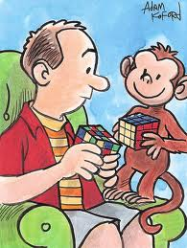
III. Observational Learning
Observational learning – learning by watching others.
Model – Person being watched in observational learning.
Modeling – Process of observing and imitating a specific behavior.
Monkey see, monkey do

Slide 20
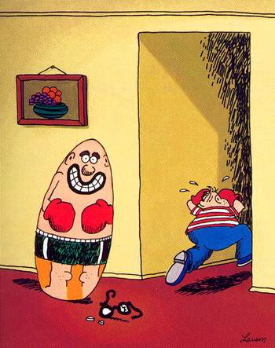
III. Observational Learning
Albert Bandura
Major figure in study of observational learning
Bobo doll experiment: We learn by watching others if the following conditions are met:
Attention (Be aware)
Retention (Remember)
Ability to reproduce the behavior
Motivation (Was the model rewarded?)

Slide 21
III. Observational Learning
Observational learning can be positive or negative (Little eyes are watching…)
What does a positive example look like?
What does a negative example look like?
Role Models (both famous and not famous)
Anti-social behavior – Negative, destructive, unhelpful behavior
Pro-social behavior – Positive, constructive, helpful behavior

Slide 22
III. Observational Learning
Media – TV, movies, video games, print media, internet
Research shows we learn aggression from what we observe
Media has the potential to be a pro-social force (Can you think of shows that are a positive influence to children?)
Viewing aggression leads to increased acceptance of aggression and increased aggressive behaviors

