Slide 1
Memory
Chapter 9

Slide 2
I. The Phenomenon of Memory
Memory – Human capacity to register, retain and remember information.
Information processing model of memory
Encoding – Getting information into our brain
Storage – Retain information
Retrieval – Get information out of our brain
Who is Clive Wearing?

Slide 3
I. The Phenomenon of Memory
Atkinson and Shiffrin’s model of memory
Sensory Memory – Memory system that holds external events from the senses up to a few seconds.
Short-Term Memory – Working memory; 20 seconds before forgotten; Capacity of 7±2 items.
Long-Term Memory – Relatively permanent storage with unlimited capacity.

Slide 4
II. Encoding
How we encode
Automatic processing – Unconscious encoding of information about space, time and frequency that occurs without interfering with our thinking about other things.
Effortful processing – Encoding that requires attention and conscious effort.
Rehearsal – Conscious repetition of information.
Spacing effect – We retain information better when rehearsal is spread over time.

Slide 5
II. Encoding
How we encode
Effortful processing
(You will have five minutes to write down the names of as many presidents as you can remember. Distinguish presidents with identical last names by including the initials of their first and, if necessary, middle names. )
Serial position effect – Better recall for information that comes at the beginning (Primacy effect) and at the end of a list of words (Recency effect).

Slide 6
II. Encoding
Encoding meaning
Semantic encoding – Encoding of meaning
Acoustic encoding – Encoding of sound
Visual encoding – Encoding of picture images
Semantic encoding is best for memory

Slide 7
II. Encoding
Encoding Imagery
Powerful aid to memory
Mnemonic devices – Memory tricks to make information easier to remember. (Ex: Method of Loci, Peg-word system, etc)

Slide 8
II. Encoding
Organizing information for encoding.
You have 10 seconds to remember the following:
KLCISNE NVESE YNA NI CSTTIH TNDO
How many do you remember?
NICKLES SEVEN ANY IN STITCH DON’T
How many do you remember?
Chunking – Organizing information into meaningful units that are easier to remember.
Examples: SSN, phone numbers, driver’s license
We remember information better when we can organize it into personally meaningful arrangements.

Slide 9
III. Storage – Retaining Information
Sensory memory specifics
Iconic memory – Momentary sensory memory of visual stimuli. (less than ½ a second)
Echoic memory – Memory sensory of auditory stimuli. (3-4 seconds)

Slide 10
III. Storage
Storing memories in the brain
Implicit memory (non-declarative) – Retention without conscious recollection of learning the skill.
Procedural memory – Tasks that we perform automatically without thinking (ex: tying our shoes)
Explicit memory (declarative) – Memory of facts and experiences that one consciously knows and can verbalize.
Semantic memory – Memory of general knowledge or facts.
Episodic memory – Memory of personally experienced events.

Slide 11
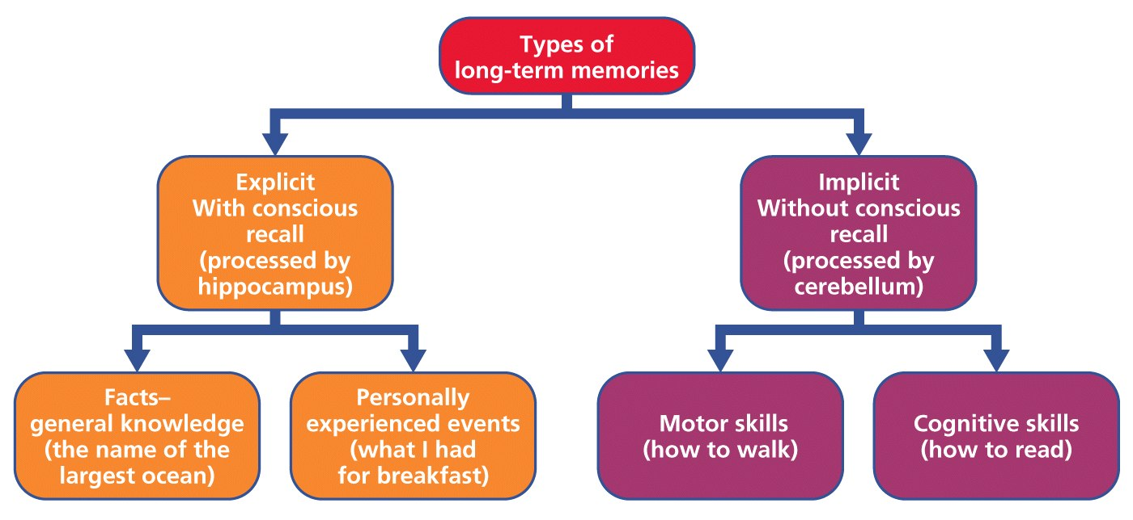
III. Storage

Slide 12
IV. Retrieval
Write down the names of the seven dwarfs.
Which of the following are the names of the seven dwarfs?
Grouchy, gabby, fearful, sleepy, smiley, jumpy, hopeful, shy, droopy, dopey, sniffy, wishful, puffy, dumpy, sneezy, lazy, pop, grumpy, bashful, cheerful, teach, shorty, nifty, happy, doc, wheezy, stubby

Slide 13
IV. Retrieval
Recall – Retrieval of information in the absence of any other information or cues (Ex: Essay test)
Recognition – Identification of something familiar (Ex: Multiple choice test)
Retrieval cues – Stimulus that provides a trigger to get an item out of memory.
Priming – Activating specific associations in memory either consciously or unconsciously.
Context effect – It helps to put yourself back into the context you experienced something.
Mood congruence – Tendency to recall experiences that are consistent with one’s current mood.

Slide 14
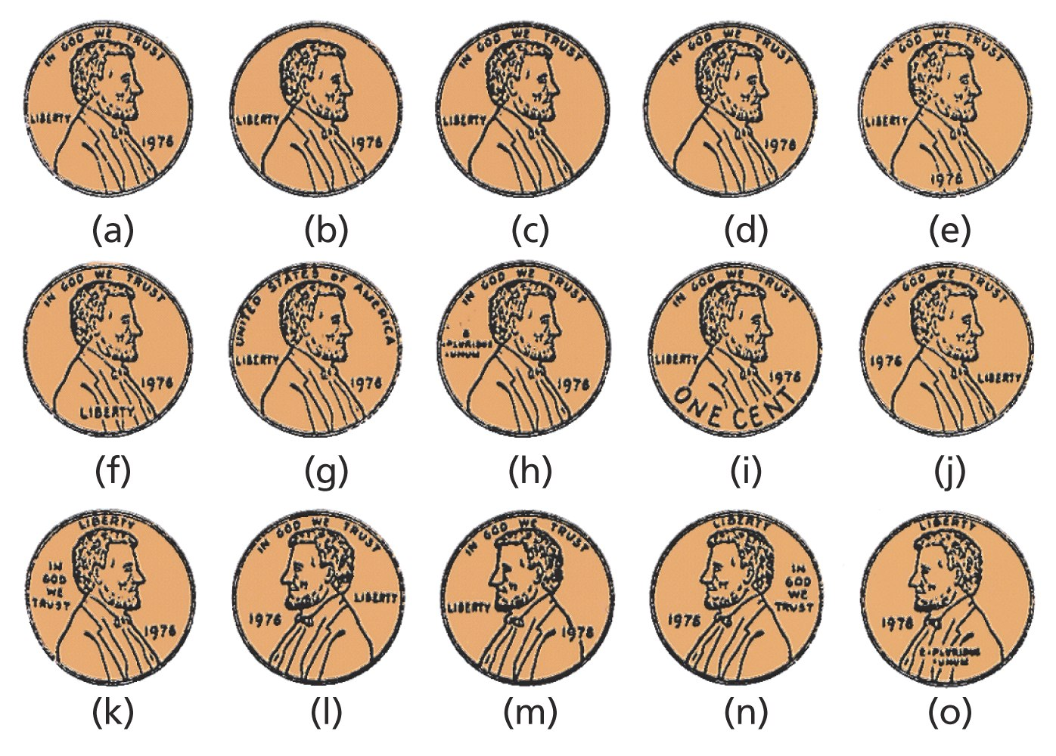
V. Forgetting
Can you pick out the real deal? Most of us can't, because we've never bothered to encode this information. The penny spends just as well whether we can identify the correct version or not. (From Nickerson & Adams, 1979.)

Slide 15
V. Forgetting
Forgetting can happen at any of the stages of memory: Encoding failure, storage failure, or retrieval failure
Difficult to forget something that you have never encoded
Storage decay – The course of forgetting is initially rapid, then levels off with time. (“forgetting curve”)

Slide 16
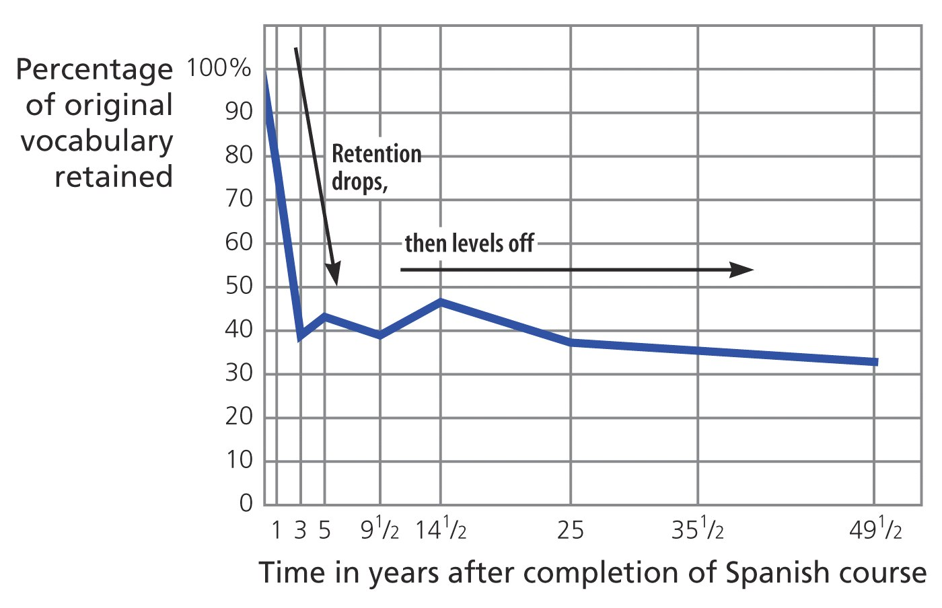

Slide 17
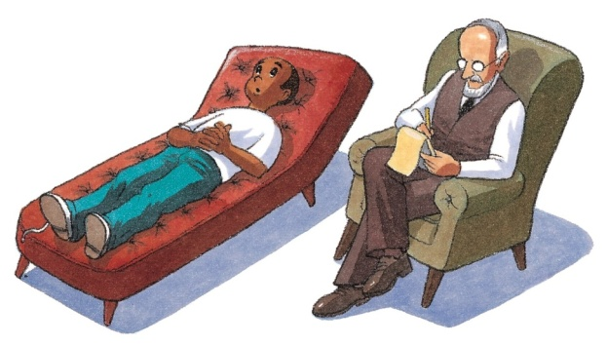
V. Forgetting
Retrieval failure
Interference
Proactive interference – Process by which old memories prevent the retrieval of new ones.
Retroactive interference – Process by which new memories prevent the retrieval of old ones.
Motivated forgetting
Repression – In psychoanalytic theory, a basic defense mechanism that banishes anxiety from the consciousness
May be retrieved by a later cue or therapy

Slide 18
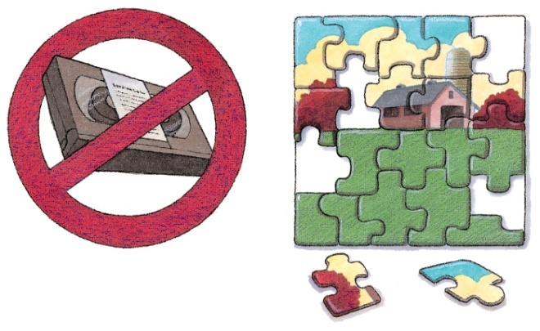
VI. Memory Construction
Misinformation effect – After exposure to subtle misinformation, many people mis-remember. (The bunny effect)
We fill in memory gaps with plausible guesses and assumptions.
Given time, the minds search for a fact may create fiction.
Source amnesia – Attributing to the wrong source an event that we have experienced, hear about, read about or imagined. (Source of many false memories.)

Slide 19
VI. Memory Construction
Children’s eyewitness recall
Children are highly suggestible
Ways to minimize false memories in kids
Use words the kids understand.
Interviewer has had no contact with the child before questioning.
Uses neutral language (does not ask leading or suggesting questions.)
Do not use an anatomically correct doll.

Slide 20
VI. Memory Construction
Memories of abuse
Traumatic events are sometimes forgotten
Theory – Memories are vivid for life threatening traumas (Ex: hurricanes, car accidents) but dulled or blocked for traumas involving betrayal.
Be cautious and avoid jumping to conclusions about retrieved memories.

